Slide 1


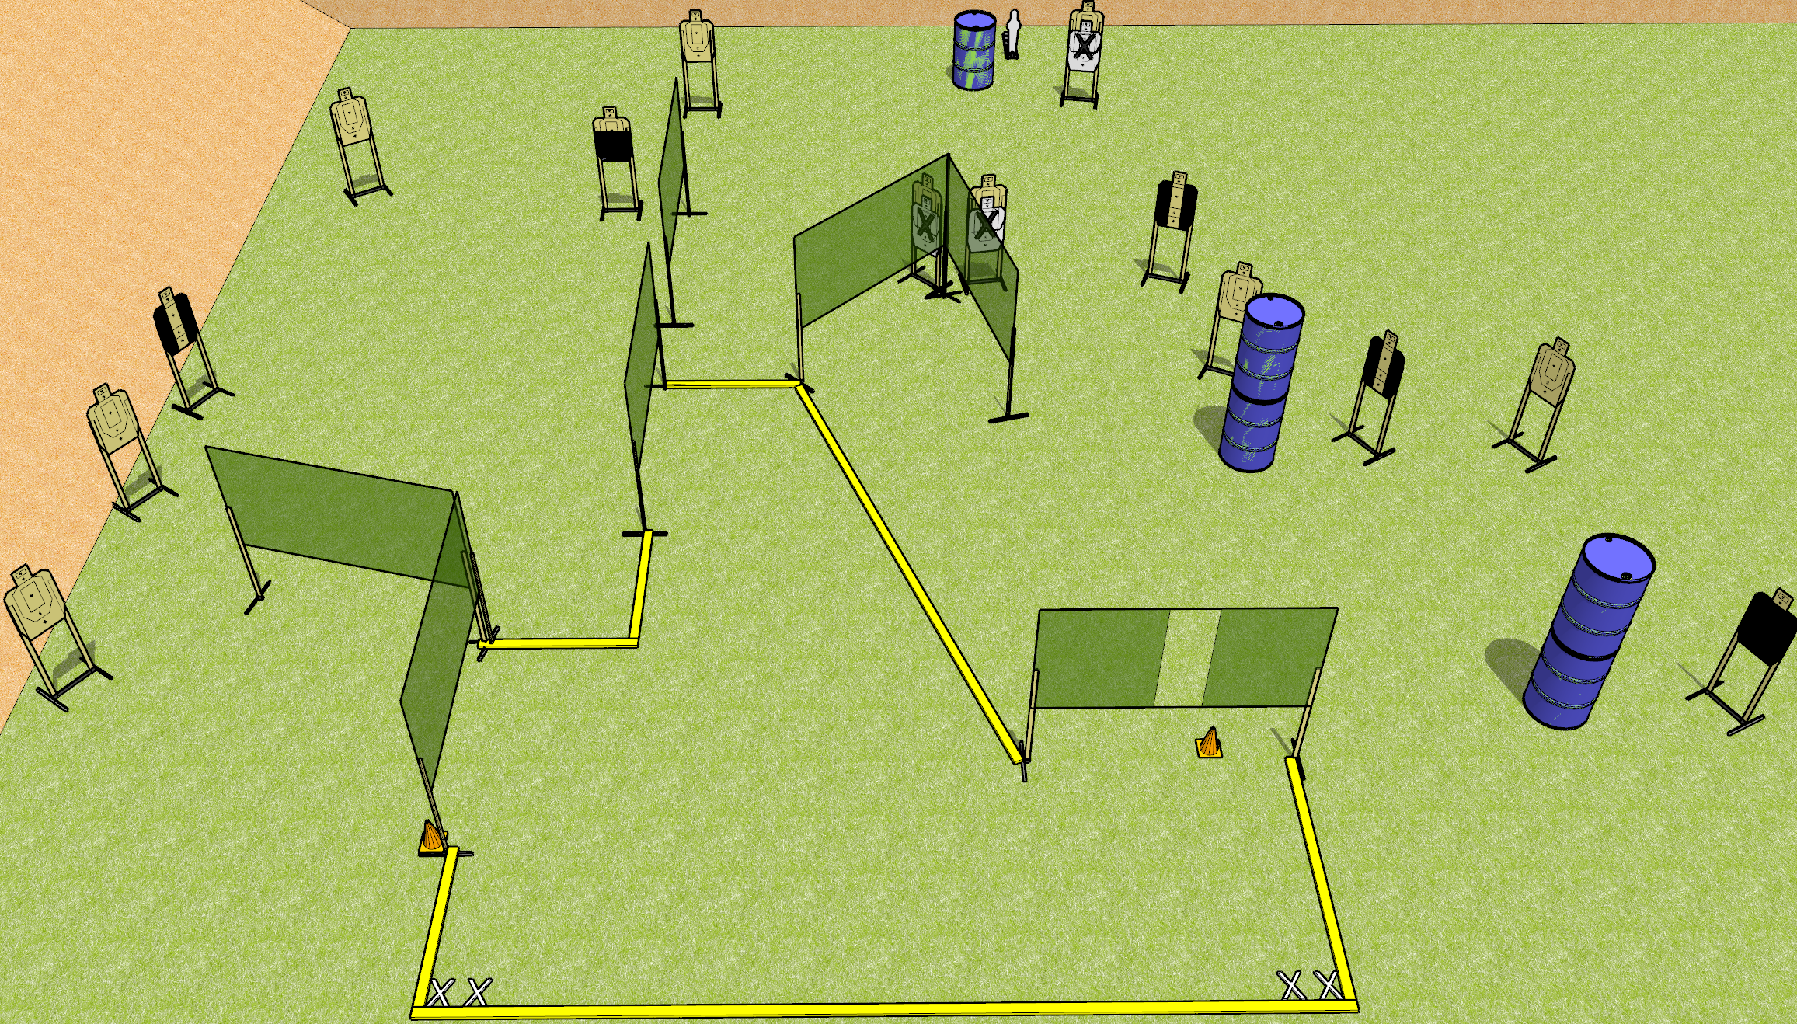
 | Dothan Gun Club – USPSA Match Shooty McShoot Face Course Designer : Drew Coleman
START POSITION : Both feet on either set of X’s, wrists above shoulders
GUN READY CONDITION : Pistol loaded and holstered. PCC loaded, held with both hands, shouldered, safety on, pointed at either orange cone. |  | SCORING: Comstock, 29 rounds TARGETS: 14 paper, 1 Steel SCORED HITS: Best 2 on paper, steel until down START-STOP: Audible, last shot RULES:
STAGE PROCEDURE: Engage targets as they become available from within the fault lines.

Slide 2
Shooty McShoot Face
Written Stage Briefing
Shooty McShoot Face is a 28 round, 140 point, Comstock field course. There are fourteen USPSA targets and one mini popper. The best two hits on paper will score, and steel must fall to score. The start signal is audible.
Handgun start position is both feet on either set of X’s, wrists above shoulders. Handgun is loaded and holstered.
PCC start position is both feet on either set of X’s, muzzle pointed at either orange cone. Loaded carbine is held with both hands, safety on, shouldered.
On start signal, engage targets from within the shooting area.

